Slide 1

Thesis Defense
Differentiable Optimization-Based Modeling for Machine Learning
Brandon Amos • Carnegie Mellon University
Thesis Committee:
J. Zico Kolter, Chair Barnabás Póczos Jeff Schneider Vladlen Koltun (Intel Labs)
The source code behind all of my work is free and publicly available:
http://github.com/bamos/thesis

Slide 2
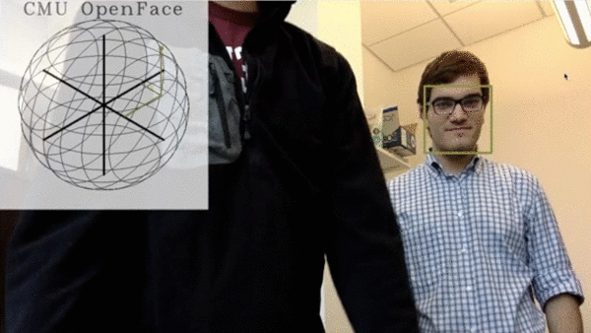
My Ph.D. Contributions
Secondary Contribution
[CMU 2016] OpenFace [ICML 2016] Collapsed Variational Inference for SPNs
[ICML 2017] Input Convex Neural Networks
[ICML 2017] OptNet
[NeurIPS 2017] Task-Based Model Learning
[ICLR 2018] Learning Awareness Models
[NeurIPS 2018] Imperfect-Information Game Solving
[NeurIPS 2018] Differentiable MPC
The Limited Multi-Label Projection Layer
Differentiable cvxpy Optimization Layers

Slide 3
This Talk
Secondary Contribution
[CMU 2016] OpenFace [ICML 2016] Collapsed Variational Inference for SPNs
[ICML 2017] Input Convex Neural Networks
[ICML 2017] OptNet
[NeurIPS 2017] Task-Based Model Learning
[ICLR 2018] Learning Awareness Models
[NeurIPS 2018] Imperfect-Information Game Solving
[NeurIPS 2018] Differentiable MPC
The Limited Multi-Label Projection Layer
Differentiable cvxpy Optimization Layers

Slide 4
Input Convex Neural Networks
A quick glimpse

Slide 5
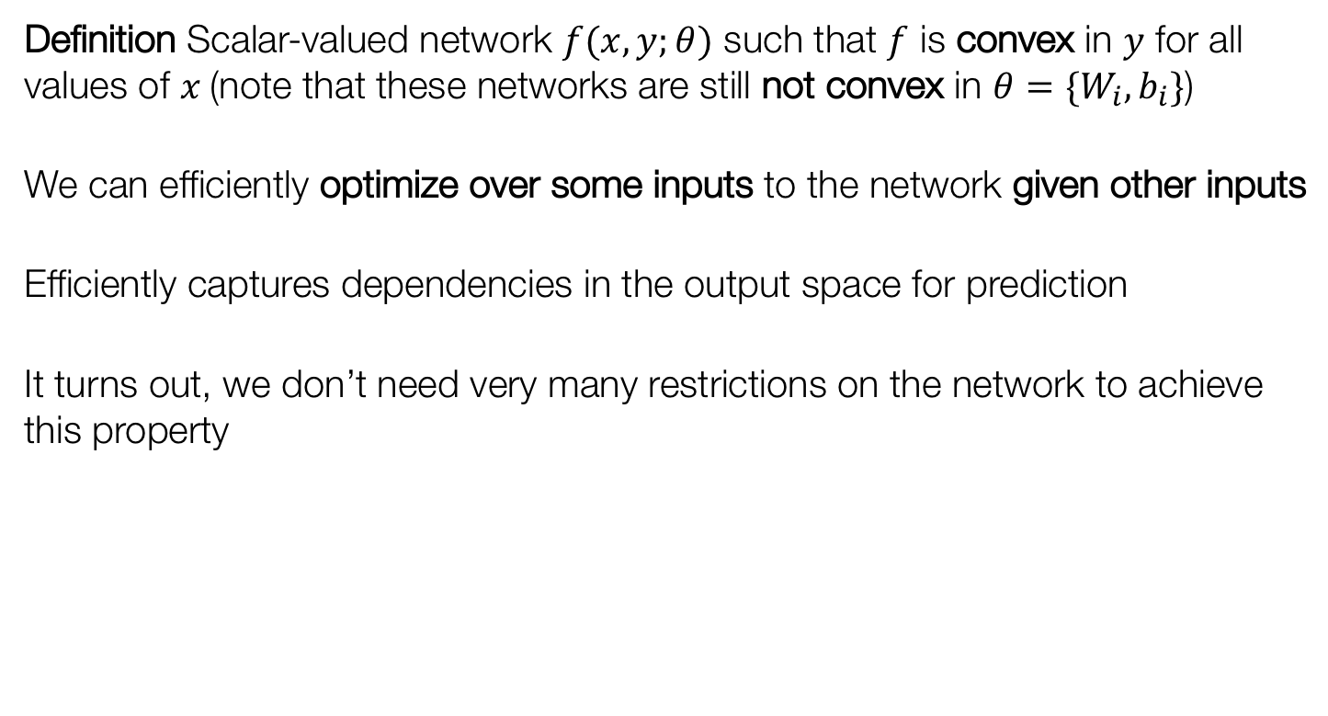
Input Convex Neural Networks (ICNNS)
Definition Scalar-valued network $f(x,y;θ)$ such that $f$ is convex in $y$ for all values of $x$(note that these networks are still not convex in $θ=\{W_{i},b_{i}\}$)
We can efficiently optimize over some inputs to the network given other inputs
Efficiently captures dependencies in the output space for prediction
It turns out, we don’t need very many restrictions on the network to achieve this property

Slide 6
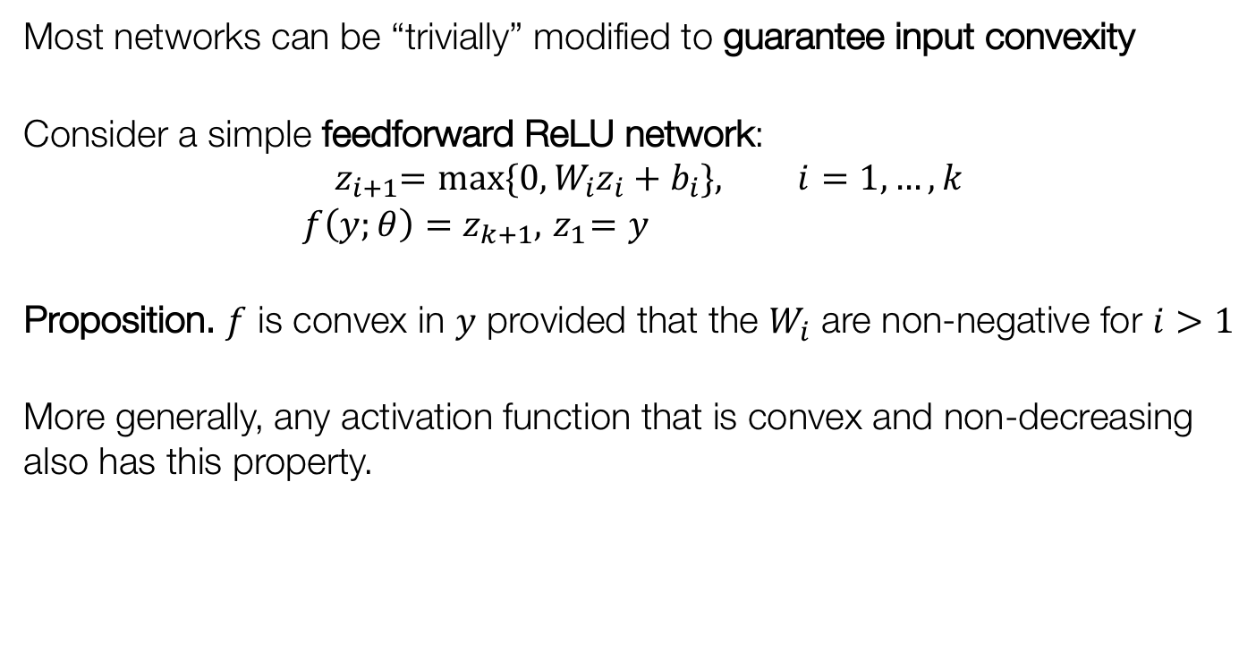
How to achieve input convexity?
Most networks can be “trivially” modified to guarantee input convexity
Consider a simple feedforward ReLU network: $${ z}_{i+1}=max\{0, W_{i}z_{i}+b_{i}\}, i=1,…,k \\ f\left(y;θ\right)=z_{k+1}, { z}_{1}=y$$
Proposition. $f$ is convex in $y$ provided that the $W_{i}$ are non-negative for $i>1$
More generally, any activation function that is convex and non-decreasing also has this property.

Slide 7
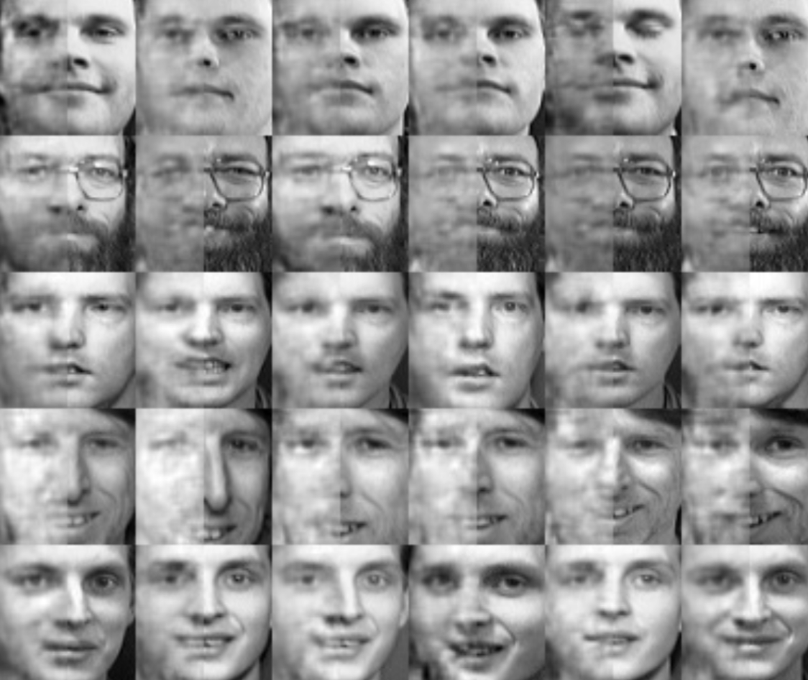
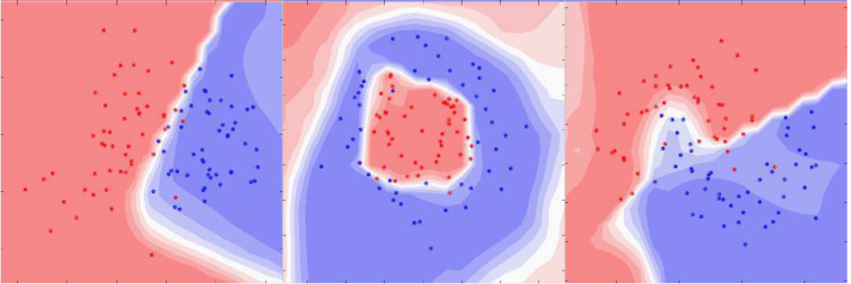
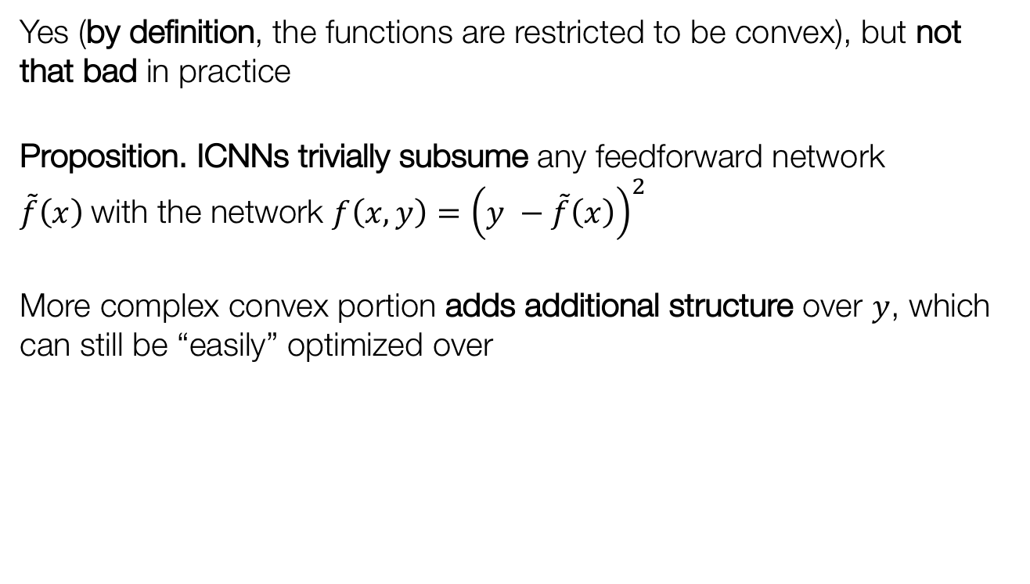
Is convexity restrictive?
Yes (by definition, the functions are restricted to be convex), but not that bad in practice
Proposition. ICNNs trivially subsume any feedforward network $\tilde{f}\left(x\right)$with the network $f\left(x,y\right)={\left(y −\tilde{f}\left(x\right)\right)}^{2}$
More complex convex portion adds additional structure over $y$, which can still be “easily” optimized over

Slide 8
Overview for the remainder of this talk
OptNet: Differentiable Optimization as a Layer in Neural Networks
Differentiable MPC
Extensions
Differentiable cvxpy Layers

Slide 9
Today’s Machine Learning Systems
A lot of data
Model
Predictions
Loss
Current Primitive Operations: Linear maps, convolutions, activation functions, random sampling, simple projections (e.g. onto the simplex or Birkhoff polytope)
How can the modeling part be improved?
Black-box neural networks don’t work everywhere and when they fail, task-specific domain knowledge can provide useful modeling priors
My work mostly focuses on ways to use optimization to inject domain knowledge into the modeling process
Notes:
+ In the ML community, we have a rich toolkit of primitive operations.
+ Where do these break down? Many ways to analyze
+ Trend lately: Showing how classical algorithms and operations can be made differentiable. I show how to do this for optimization
+ *Not* parameter optimization

Slide 10
Optimization and Machine Learning
Non-convex optimization is thriving in machine learning for parameter optimization and architecture search. This is not what this talk covers.
In this talk, we argue that optimization is also a useful operation for inference and control.
We consider optimization as another potential layer, to be composed with others
Why? Optimization is an extremely powerful paradigm for decision-making.
Applications in finance (Markowitz portfolio optimization), machine learning (support vector machines), control (linear-quadratic model predictive control), geometry (projections onto polyhedra)

Slide 11
Why is optimization a useful primitive operation in learning systems?
We have incomplete domain knowledge about what we want to model
Fill in parts of the optimization problem that we know
Use data to learn the parts that we don’t
Also subsumes many standard layers (ReLU, sigmoid, softmax)
We will show this later
A lot of data
Model
Predictions
Loss
(Learned) Abstract Representation
(Learned) Solver

Slide 12
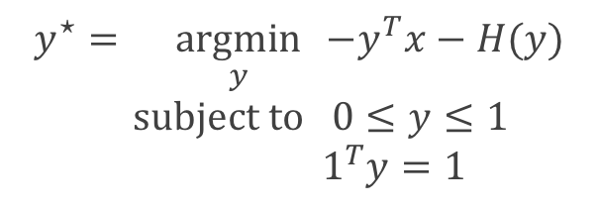
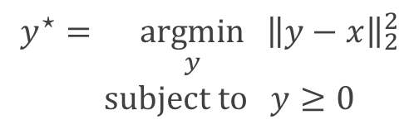
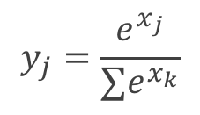
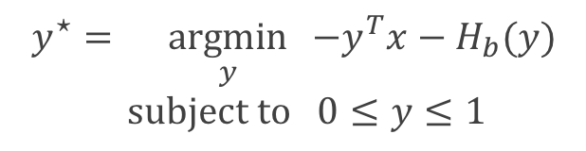
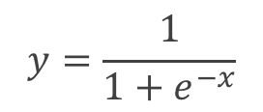
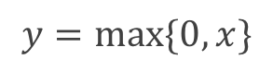
Convex optimization viewpoint of standard layers
$$y^{⋆}=\underset{y}{argmin}{ {\left\|y−x\right\|}_{2}^{2}} \\ \text{subject} \text{to} y≥0$$
ReLU
$$y=\max{\{0, x\}}$$
$$y=\frac{1}{1+e^{−x}}$$
$$y^{⋆}=\underset{y}{argmin}{ −y^{T}x−H_{b}(y)} \\ \text{subject} \text{to} 0≤y≤1$$
Sigmoid
$$y^{⋆}=\underset{y}{argmin}{ −y^{T}x−H(y)} \\ \text{subject} \text{to} 0≤y≤1$$
$$1^{T}y=1$$
$$y_{j}=\frac{e^{x_{j}}}{∑e^{x_{k}}}$$
Softmax
Notes:
Useful to illustrate the representational power of these layers

Slide 13


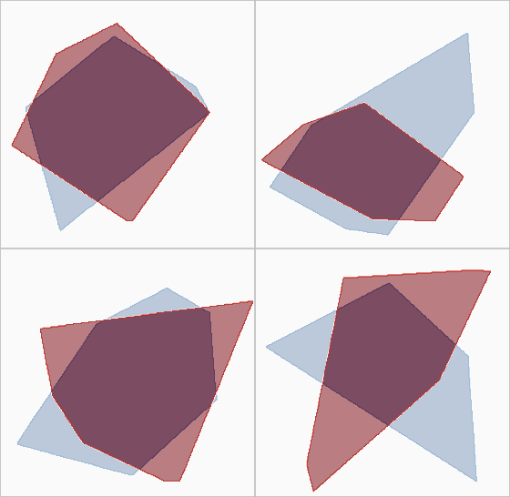
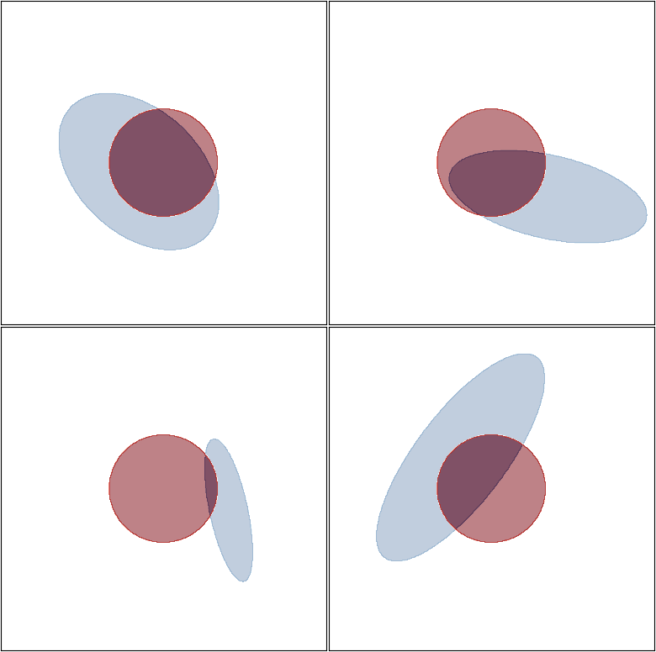
OptNet Application: Modeling Constraints
True Constraint (Unknown to the model)
Constraint Predictions During Training
Example 1
Example 2
Example 1
Example 2
Example 3
Example 4
Example 3
Example 4

Slide 14
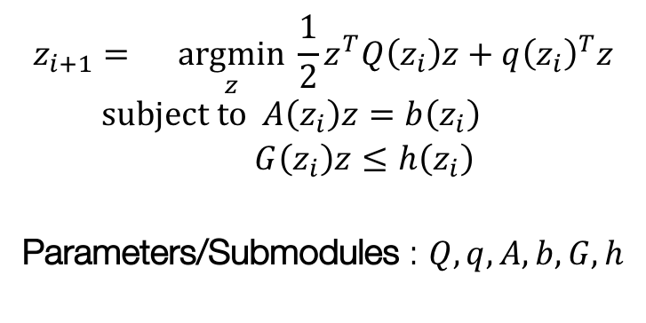
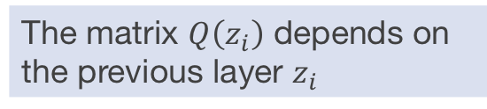
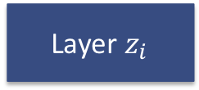
The OptNet Layer
A lot of data
Model
Predictions
Loss
…
Layer $z_{i}$
OptNet Layer
…
$$z_{i+1}=\underset{z}{argmin}{\frac{1}{2}z^{T}Q\left(z_{i}\right)z+q{\left(z_{i}\right)}^{T}z} \\ subject to A\left(z_{i}\right)z=b\left(z_{i}\right) \\ G\left(z_{i}\right)z≤h\left(z_{i}\right)$$
Parameters/Submodules : $Q,q,A,b,G,h$
The matrix $Q\left(z_{i}\right)$ depends on the previous layer $z_{i}$
Notes:
+ We could hard-code in values for the objective or constraints but we don't have to
+ Argmin gives well-defined output under some assumptions

Slide 15
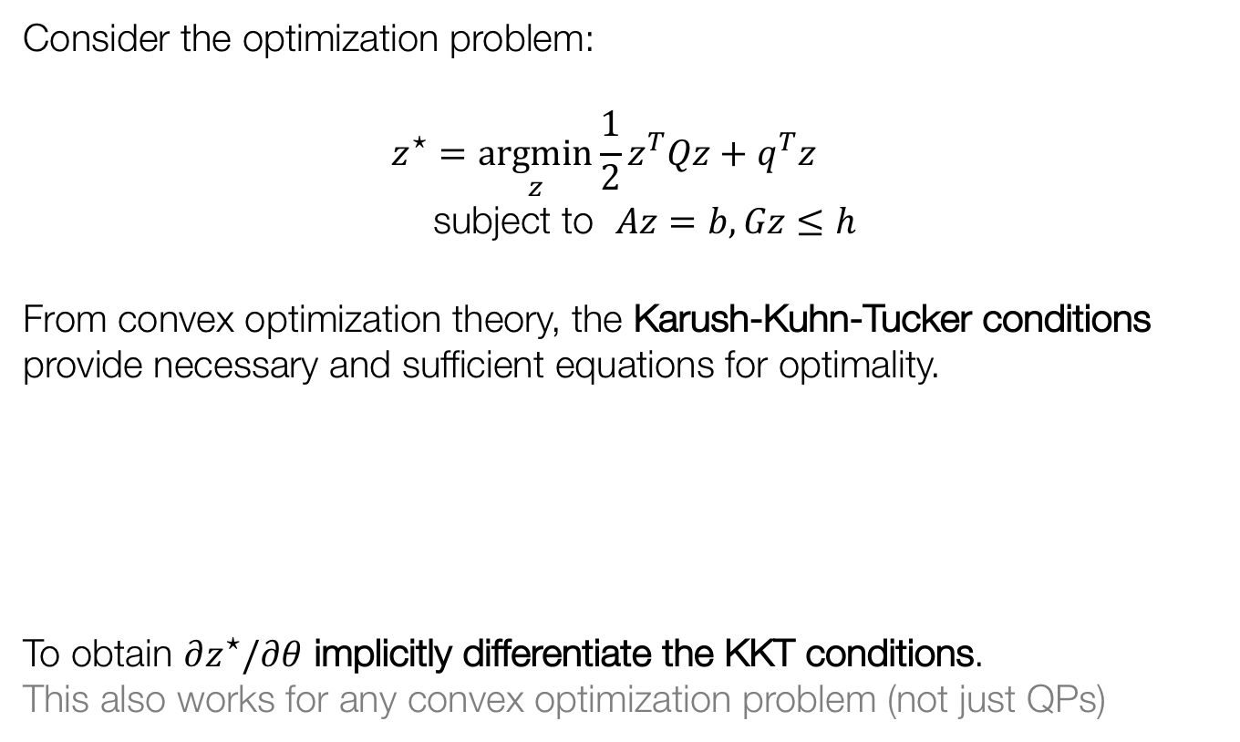
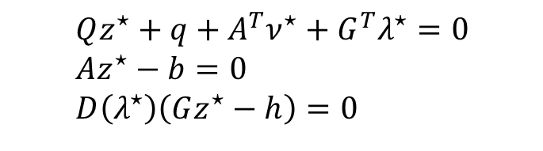
Differentiating a quadratic argmin
Consider the optimization problem:
$$z^{⋆}=\underset{z}{argmin}{\frac{1}{2}z^{T}Qz+q^{T}z} \\ \text{subject} \text{to} Az=b, Gz≤h$$
From convex optimization theory, the Karush-Kuhn-Tucker conditions provide necessary and sufficient equations for optimality.
To obtain $∂z^{⋆}/∂θ$ implicitly differentiate the KKT conditions. This also works for any convex optimization problem (not just QPs)
stationarity primal feasibility complementary slackness
$$Qz^{⋆}+q+A^{T}ν^{⋆}+G^{T}λ^{⋆}=0 \\ Az^{⋆}−b=0 \\ D\left(λ^{⋆}\right)\left(Gz^{⋆}−h\right)=0$$

Slide 16
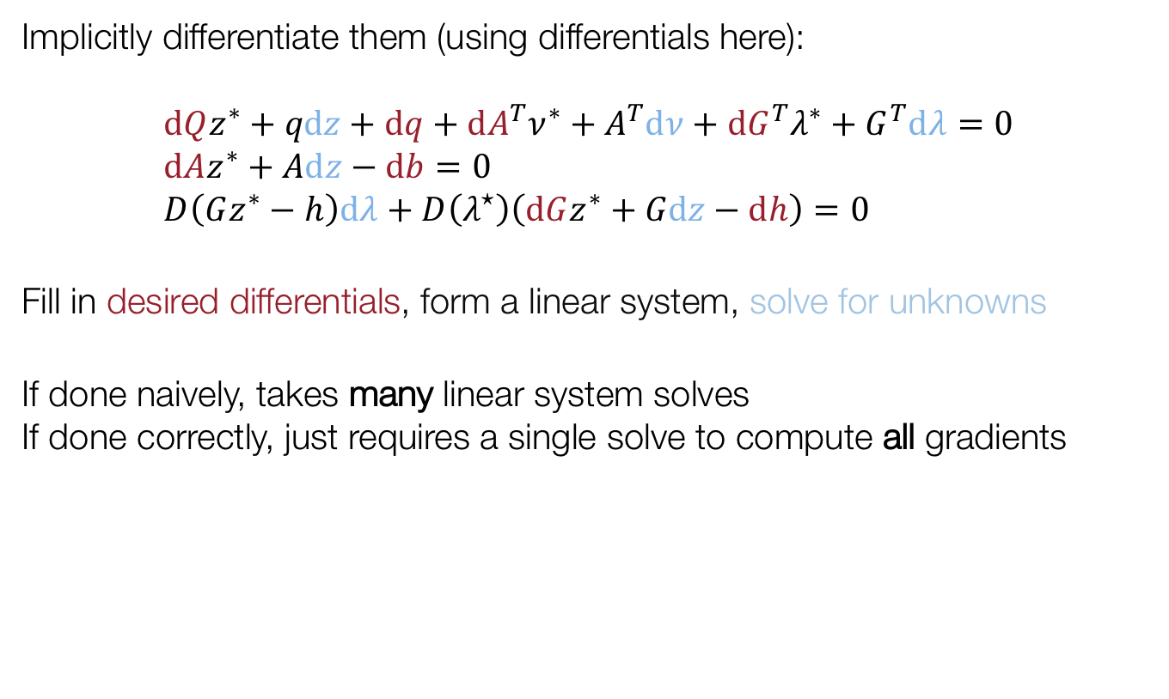
Implicitly differentiating the KKT conditions
Implicitly differentiate them (using differentials here):
$$\text{d}Qz^{∗}+q\text{d}z+\text{d}q+\text{d}A^{T}ν^{∗}+A^{T}\text{d}ν+\text{d}G^{T}λ^{∗}+G^{T}\text{d}λ=0 \\ \text{d}Az^{∗}+A\text{d}z−\text{d}b=0 \\ D\left(Gz^{∗}−h\right)\text{d}λ+D\left(λ^{⋆}\right)\left(\text{d}Gz^{∗}+G\text{d}z−\text{d}h\right)=0$$
Fill in desired differentials, form a linear system, solve for unknowns
If done naively, takes many linear system solves If done correctly, just requires a single solve to compute all gradients

Slide 17
A Simple Application: Sudoku
Notes:
Actually integer programming

Slide 18
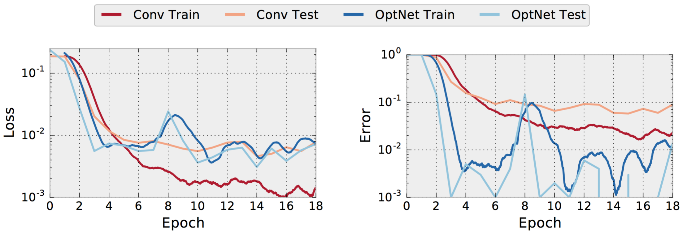
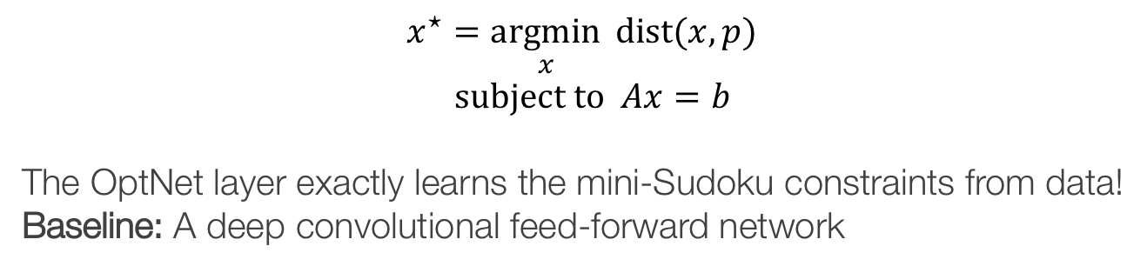
OptNet Learns Sudoku
$$x^{⋆}=\underset{x}{argmin}{ \text{dist}(x, p)} \\ \text{subject} \text{to} Ax=b$$
The OptNet layer exactly learns the mini-Sudoku constraints from data!
Baseline: A deep convolutional feed-forward network
% Incorrectly Solved Boards
Notes:
+ Define loss/error
+ Something I didn’t mention earlier: training/test set for ML

Slide 19
Overview for the remainder of this talk
OptNet: Differentiable Optimization as a Layer in Neural Networks
Differentiable MPC
Extensions
Differentiable cvxpy Layers

Slide 20
Should RL policies have a system dynamics model or not?
Policy
Neural Network(s)
State
Action
System Dynamics
Future Plan
Model-free RL
More general, doesn’t make as many assumptions about the world
Rife with poor data efficiency and learning stability issues
Model-based RL (or control)
A useful prior on the world if it lies within your set of assumptions

Slide 21
Combining model-based and model-free RL
Recently there has been a lot of interest in model-based priors for model-free reinforcement learning:
Among others: Dyna-Q (Sutton, 1990), GPS (Levine and Koltun, 2013), Imagination-Augmented Agents (Weber et al., 2017), Value Iteration Networks (Tamar et al., 2016), TreeQN (Farquhar et al., 2017)
These typically involve:
Using an RNN: Efficient but not as expressive and general as MPC/iLQR
Unrolling an LQR or gradient-based solver: Expressive/general but inefficient
Our approach: Differentiable Model-Predictive Control
Explicitly solves a control problem

Slide 22
Our Approach: Model Predictive Control

Slide 23
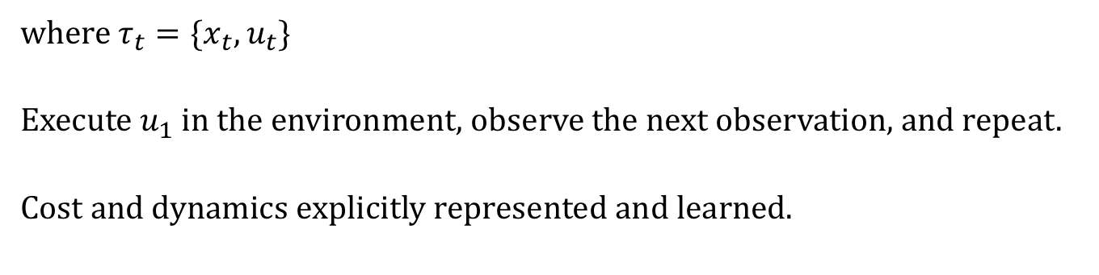
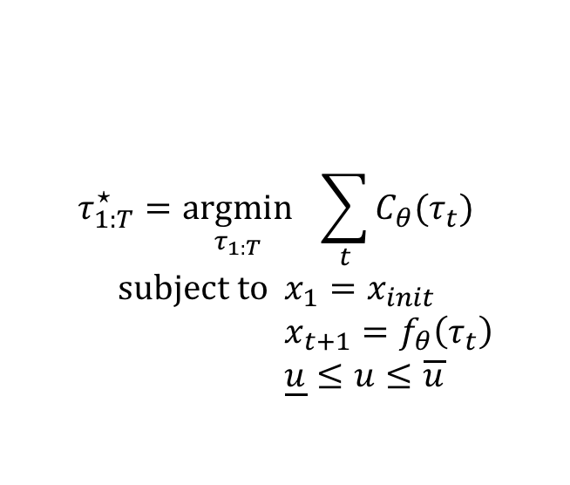
Our Approach: Model Predictive Control
Traditionally viewed as a pure planning problem given known (potentially non-convex) cost and dynamics:
$$τ_{1:T}^{⋆}=\underset{τ_{1:T}}{argmin}{ \sum_{t}{C_{θ}(τ_{t})}} \\ \text{subject} \text{to} x_{1}=x_{init} \\ x_{t+1}=f_{θ}\left(τ_{t}\right) \\ \underline{u}≤u≤\overline{u}$$
Cost
Dynamics
where $τ_{t}=\{x_{t}, u_{t}\}$
Execute $u_{1}$ in the environment, observe the next observation, and repeat.
Cost and dynamics explicitly represented and learned.

Slide 24
Model Predictive Control with SQP
The standard way of solving MPC is to use sequential quadratic programming (SQP), using LQR in most cases
Form approximations to the cost and dynamics around the current iterate
Repeat until a fixed point is reached and differentiate through it

Slide 25
LQR, KKT Systems, and Differentiation
Solving LQR with dynamic Riccati recursion efficiently solves the KKT system
Backwards Pass: Use the OptNet approach from [Amos and Kolter, 2017] to implicitly differentiate the LQR KKT conditions:
where
Just another LQR problem!

Slide 26
LQR, KKT Systems, and Differentiation
Solving LQR with dynamic Riccati recursion efficiently solves the KKT system
Backwards Pass: Use the OptNet approach from [Amos and Kolter, 2017] to implicitly differentiate the LQR KKT conditions:
where
Just another LQR problem!

Slide 27
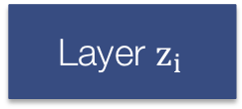
A Differentiable MPC Module
We can differentiate through (non-convex) MPC with a single (convex) LQR solve by differentiating the SQP fixed point
A lot of data
Model
Predictions
Loss
…
Layer $z_{i}$
MPC Layer
…
What can we do with this now?
Replace neural network policies in model-free algorithms with MPC policies, and also replace the unrolled controllers in other settings (hindsight plan, universal planning networks)
The cost can also be learned! No longer have to hard-code in a known value.

Slide 28
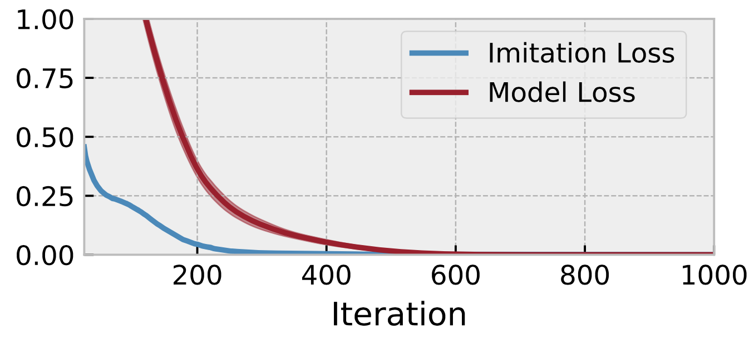
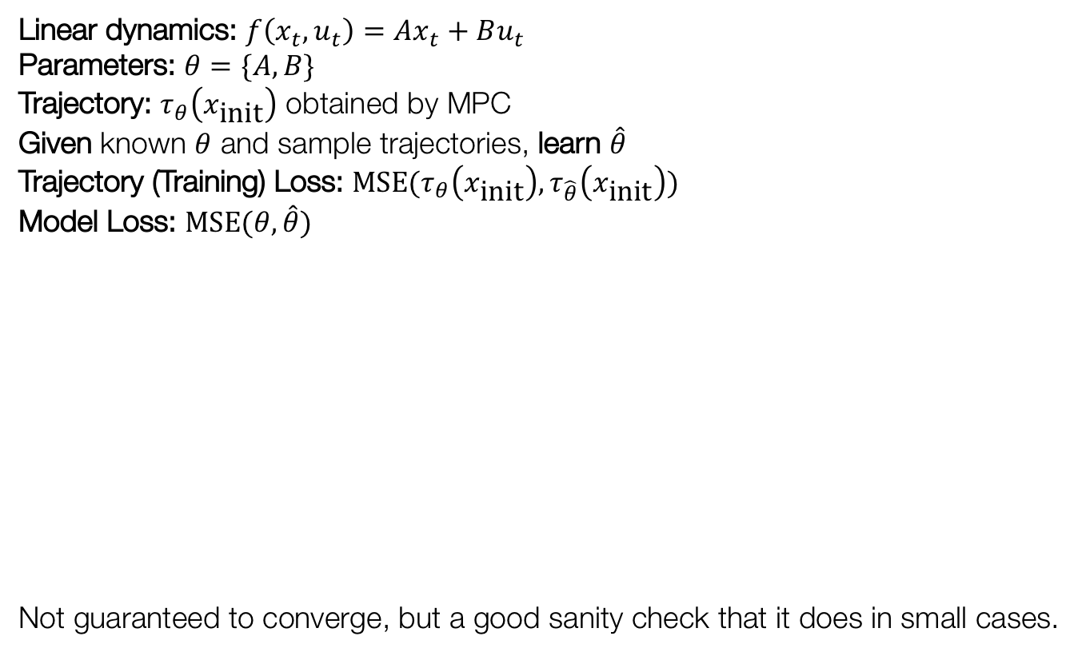
Imitation learning with a linear model
Linear dynamics: $f\left(x_{t}, u_{t}\right)=Ax_{t}+Bu_{t}$
Parameters: $θ=\{A, B\}$
Trajectory: $τ_{θ}\left(x_{\text{init}}\right)$ obtained by MPC
Given known $θ$ and sample trajectories, learn $\hat{θ}$
Trajectory (Training) Loss: $\text{MSE}(τ_{θ}\left(x_{\text{init}}\right), τ_{\hat{θ}}\left(x_{\text{init}}\right))$
Model Loss: $\text{MSE}(θ, \hat{θ})$
Not guaranteed to converge, but a good sanity check that it does in small cases.

Slide 29
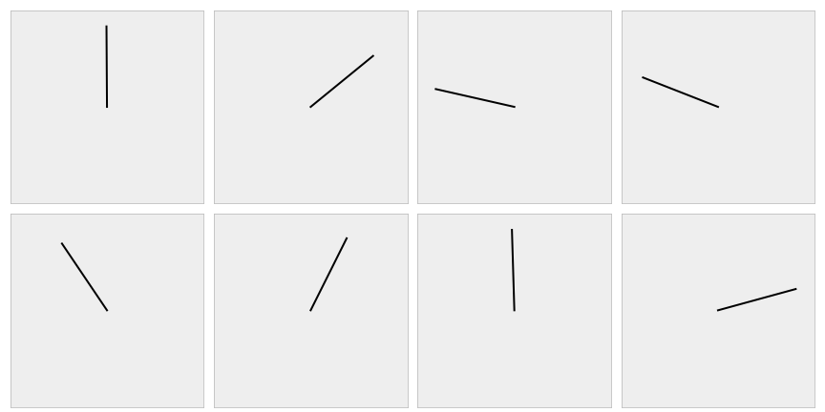
Simple Pendulum Control

Slide 30
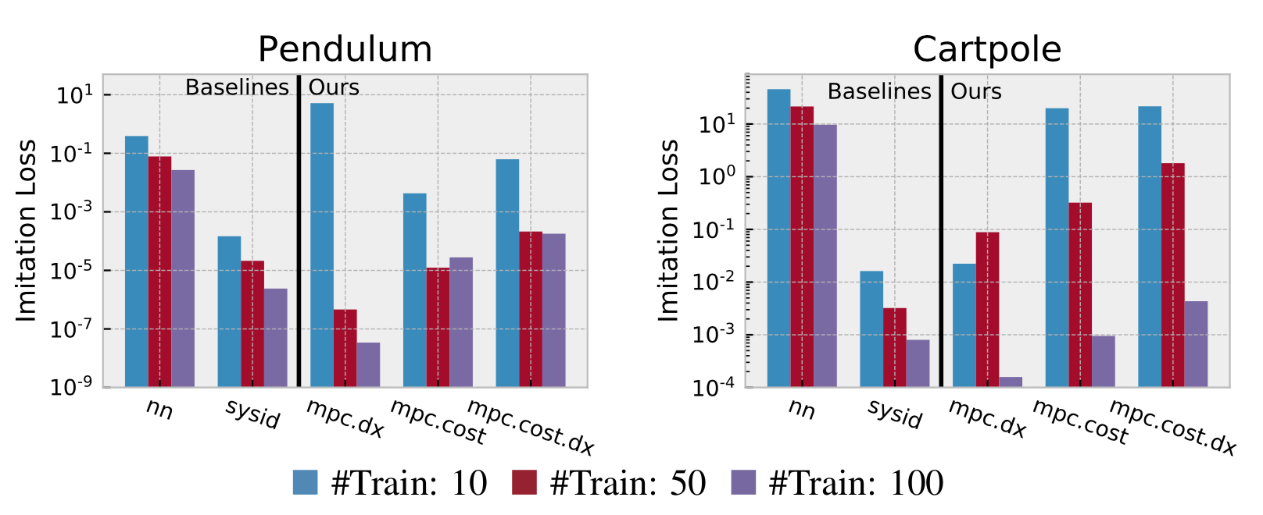
Imitation learning with the pendulum/cartpole
Again optimizes the imitation loss with respect to the controller’s parameters
Using only action trajectories we can recover the true parameters

Slide 31
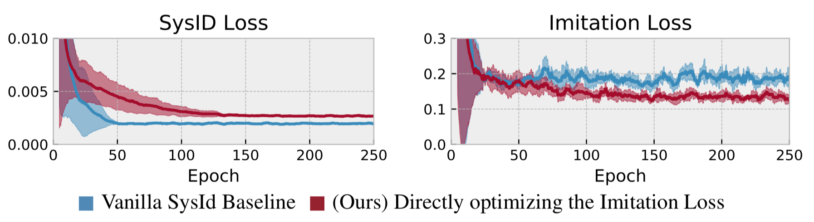
Optimizing the task loss is often better than SysID in the unrealizable case
True System: Pendulum environment with noise (damping and a wind force) Approximate Model: Pendulum without the noise terms
~1.8x difference!
Best Imitation Loss
Approximate Model Class
True Model
Best MSE

Slide 32
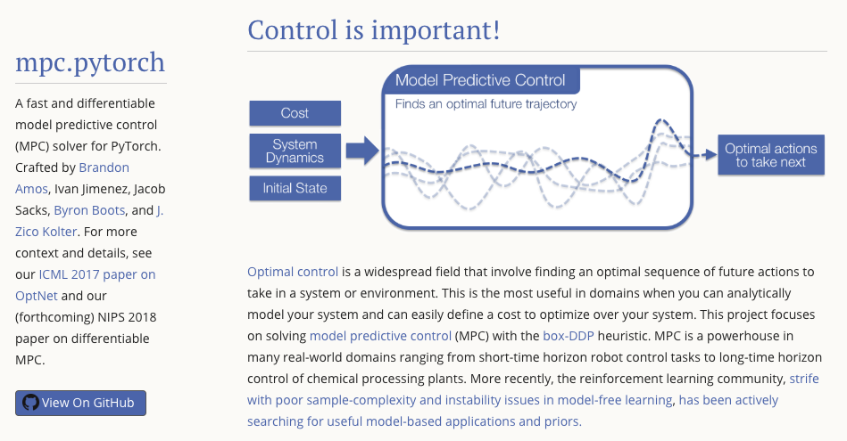
A PyTorch MPC Solver
https://locuslab.github.io/mpc.pytorch

Slide 33
Overview for the remainder of this talk
OptNet: Differentiable Optimization as a Layer in Neural Networks
Differentiable MPC
Extensions
Differentiable cvxpy Layers

Slide 34
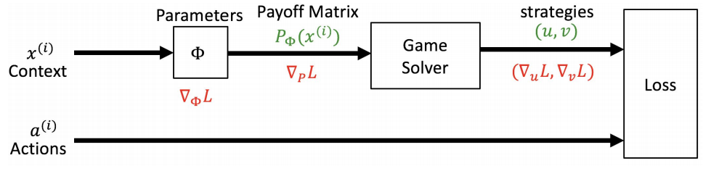
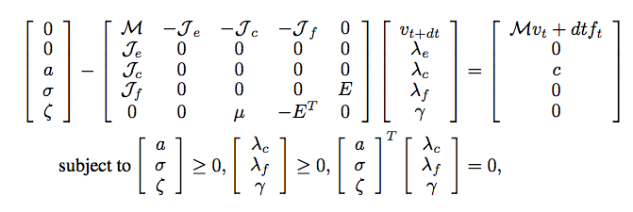
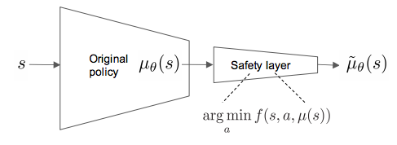
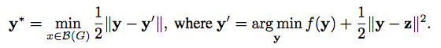
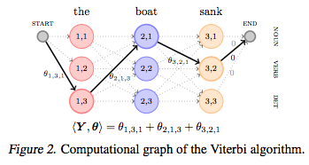
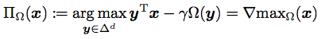
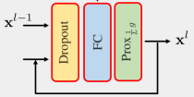
Extensions
Section 2 and Section 8 of my thesis document contain a more complete set of references
Game Theory [Ling, Fang, and Kolter; IJCAI 2017]: Distinguished Paper Award
Stochastic optimization and end-to-end learning [Donti, Amos, and Kolter; NeurIPS 2017]
Reinforcement learning and control Safety [Dalal et al. 2018], physics-based modeling [Peres et al. NeurIPS 2018], inverse cost and reward learning, multi-agent systems, learnable embeddings
Discrete, combinatorial, and submodular optimization [Djolonga and Krause 2017, Niculae and Blondel 2017, Mensch and Blondel 2018]
Optimization viewpoints of standard components [Bibi et al. ICLR 2019]

Slide 35
Overview for the remainder of this talk
OptNet: Differentiable Optimization as a Layer in Neural Networks
Differentiable MPC
Extensions
Differentiable cvxpy Layers

Slide 36
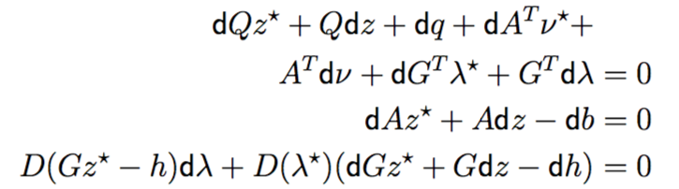
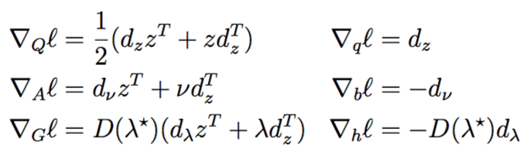
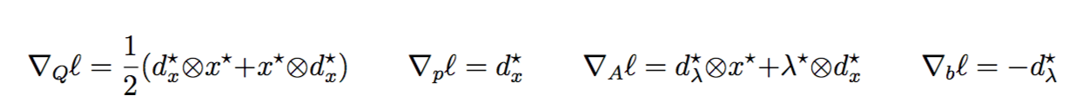
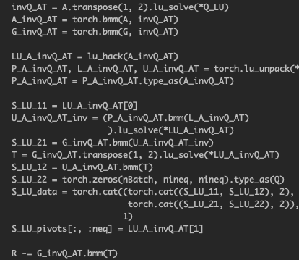
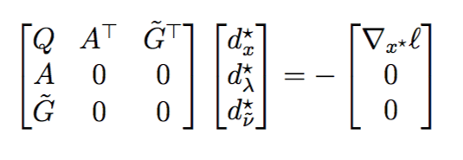
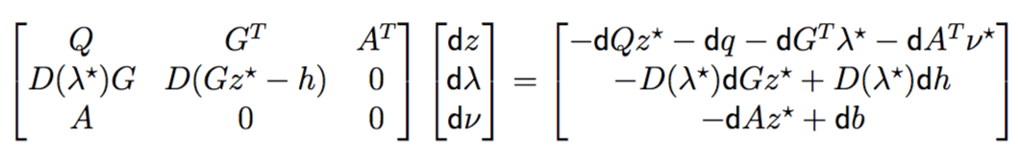
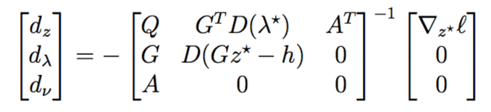
Hand-Implementing Optimization Layers is Hard

Slide 37
Why should practitioners care?

Slide 38
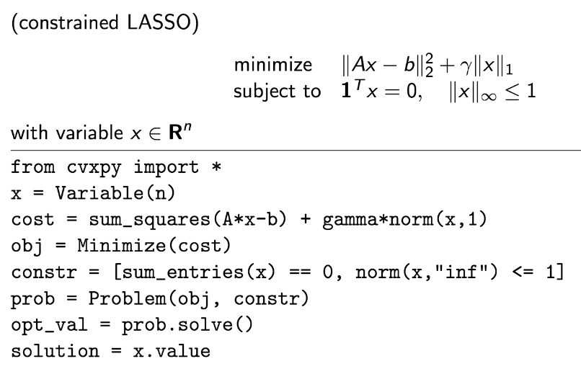
cvxpy
http://cvxpy.org
[Diamond2018]

Slide 39
A new way of rapidly prototyping optimization layers

Slide 40
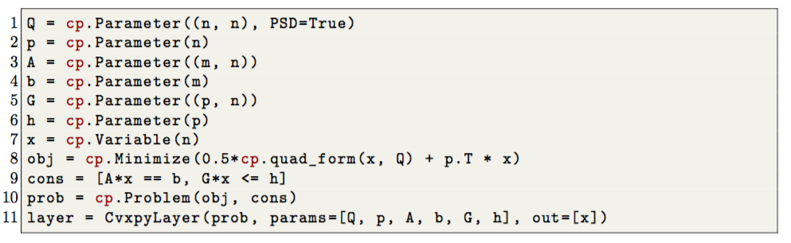
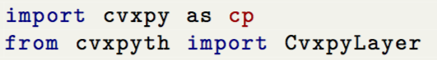
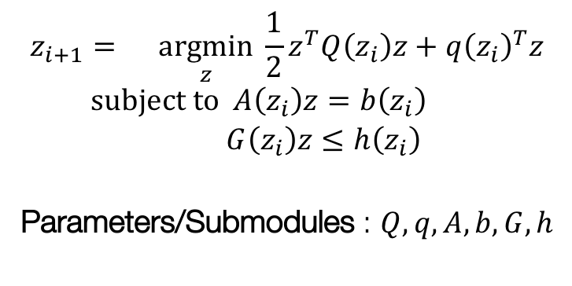
Code example: OptNet QP
Before: 1k lines of code Hand-implemented and optimized PyTorch GPU-capable batched primal-dual interior point method
Now: 10 lines of code Same speed
$$z_{i+1}=\underset{z}{argmin}{\frac{1}{2}z^{T}Q\left(z_{i}\right)z+q{\left(z_{i}\right)}^{T}z} \\ subject to A\left(z_{i}\right)z=b\left(z_{i}\right) \\ G\left(z_{i}\right)z≤h\left(z_{i}\right)$$
Parameters/Submodules : $Q,q,A,b,G,h$

Slide 41
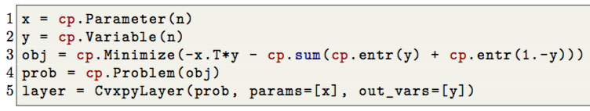



Code example: The sigmoid
$$y=\frac{1}{1+e^{−x}}$$
$$y^{⋆}=\underset{y}{argmin}{ −y^{T}x−H_{b}(y)} \\ \text{subject} \text{to} 0≤y≤1$$

Slide 42
OptNet Application: Modeling Constraints
True Constraint (Unknown to the model)
Constraint Predictions During Training
Example 1
Example 2
Example 1
Example 2
Example 3
Example 4
Example 3
Example 4

Slide 43






Code example: Constraint modeling

Slide 44
What’s going on behind the scenes?
Cone Program Differentiation
Much more general than the QPs we considered in OptNet
Question from my thesis proposal: How to differentiate non-polyhedral cones?
Non-trivial because we can’t easily differentiate the KKT conditions of cone programs because of non-trivial cone constraints

Slide 45



Cone Program Differentiation
Take the homogenous self-dual embedding of the cone program
$Qu=v$ where
Definition: Minty’s projection onto the embedding space ${M: ℝ}^{m+n+1}→𝒞 M\left(z\right)=\left(Πz, −Π^{∗}z\right)$ where $𝒞= \left\{\left(u,v\right)∈𝓚×𝓚^{∗} \right|u^{T}v=0\}$
Take the residual map of Minty’s parameterization: $$ℛ\left(z\right)=QΠz+Π^{∗}z$$
Implicitly differentiate $ℛ$:
$$D_{θ}\left(z\right)=−{\left(D_{z}ℛ\left(z^{∗}\right)\right)}^{−1}D_{θ}R\left(z^{∗}\right)$$
Captures KKT differentiation as a special case

Slide 46
Closing Thoughts And Future Directions
Optimization is a powerful primitive to use within larger systems
This thesis has uncovered theoretical and engineering foundations
Can be propagated through and learned, just like any layer
Provides a perspective to analyze existing models and layers
Can be used to project onto sets in a differentiable way Even if a closed form solution doesn’t exist
Applications in:
Model-based RL and control
In the policy or for exploration
Inverse control, cost learning
Learning embedded state spaces for planning
Multi-agent systems Interpret other agents as solving optimization problems
Meta-Learning
Energy-based learning and structured prediction
Notes:
The days of throwing black-box neural nets at problems are (almost) over

Slide 47
Closing Thoughts And Future Directions
Optimization is a powerful primitive to use within larger systems
This thesis has uncovered theoretical and engineering foundations
Can be propagated through and learned, just like any layer
Provides a perspective to analyze existing models and layers
Can be used to project onto sets in a differentiable way Even if a closed form solution doesn’t exist
Applications in:
Model-based RL and control
In the policy or for exploration
Inverse control, cost learning
Learning embedded state spaces for planning
Multi-agent systems Interpret other agents as solving optimization problems
Meta-Learning
Energy-based learning and structured prediction

Slide 48


Thesis Defense
Differentiable Optimization-Based Modeling for Machine Learning
Brandon Amos • Carnegie Mellon University
The source code behind all of my work is free and publicly available:
http://github.com/bamos/thesis

Slide 49
Extra Slides

Slide 50




Optimization-Based Inference
Structured prediction: define a network over $𝒳×𝒴$ and predict via $$\hat{y}(x)={argmin}_{y} f(x, y;θ)$$
*This is also called energy-based modeling
Input $x$
$$f(x,y;θ)$$
Dog
Lion
Cat
$$y$$

Slide 51


Structured prediction models nicely capture dependencies in the output space
Especially useful for high-dimensional, correlated output spaces
Multi-label classification
Semantic segmentation
Scene-graph generation
Difficult to capture with most feed-forward models
Intractable in many graphical models if a special structure is not imposed
Like in MRFs/CRFs
Easy with energy-based models
Just add them to the energy $f_{θ}\left(x,y\right)$
[Zellers2018]

Slide 52

Energy-based models have historically been used for many tasks
Historically these have relied on shallow energy functions and hand-engineered features
We show how to use a deep convex energy-based model with learned features
[LeCun2006]

Slide 53

Optimization-Based Inference
Structured prediction: define a network over $𝒳×𝒴$ and predict via $$\hat{y}(x)={argmin}_{y} f(x,y;θ)$$
Data imputation: build a network over only over $𝒴$, given $y_{ℐ}$ populate the remaining entries via $${\hat{y}}_{\overline{ℐ}}={argmin}_{y_{\overline{ℐ}}} f\left(y_{\overline{ℐ}},y_{ℐ};θ\right)$$
Continuous action reinforcement learning: Represent $Q$ function as $Q^{⋆}\left(s,a\right)=−f(s,a;θ)$, policy becomes $$π^{⋆}\left(s\right)={argmin}_{a}f\left(s,a;θ\right)$$

Slide 54
ICNN Portion Overview
Our Contribution: Input Convex Neural Networks
Challenges: Inference and Learning
Experiments
Synthetic
Multi-label Classification
Image Completion
Continuous–Action Q-Learning

Slide 55

Input Convex Neural Networks (ICNNS)
Definition Scalar-valued network $f(x,y;θ)$ such that $f$ is convex in $y$ for all values of $x$(note that these networks are still not convex in $θ=\{W_{i},b_{i}\}$)
We can efficiently optimize over some inputs to the network given other inputs
Efficiently captures dependencies in the output space for prediction
It turns out, we don’t need very many restrictions on the network to achieve this property

Slide 56

Applications of Optimization for Inference
With ICNNs: All of these problems are convex, “easy” to solve globally
Structured prediction: define a network over $𝒳×𝒴$ and predict via $$\hat{y}(x)={argmin}_{y} f(x,y;θ)$$
Data imputation: build a network over only over $𝒴$, given $y_{ℐ}$ populate the remaining entries via $${\hat{y}}_{\overline{ℐ}}={argmin}_{y_{\overline{ℐ}}} f\left(y_{\overline{ℐ}},y_{ℐ};θ\right)$$
Continuous action reinforcement learning: Represent $Q$ function as $Q^{⋆}\left(s,a\right)=−f(s,a;θ)$, policy becomes $$π^{⋆}\left(s\right)={argmin}_{a}f\left(s,a;θ\right)$$

Slide 57



Example Networks
ICNN for structured prediction: $$\hat{y}(x)={argmin}_{y} f(x,y;θ)$$
ICNN for Q learning: $$π^{⋆}\left(s\right)={argmin}_{a}−Q\left(s,a;θ\right)$$
State
$$−Q(s,a;θ)$$
Features
$$f(x,y;θ)$$
Class
Prediction
Action

Slide 58
How to achieve input convexity?
Most networks can be “trivially” modified to guarantee input convexity
Consider a simple feedforward ReLU network: $${ z}_{i+1}=max\{0, W_{i}z_{i}+b_{i}\}, i=1,…,k \\ f\left(y;θ\right)=z_{k+1}, { z}_{1}=y$$
Proposition. $f$ is convex in $y$ provided that the $W_{i}$ are non-negative for $i>1$
More generally, any activation function that is convex and non-decreasing also has this property.

Slide 59

Is convexity restrictive?
Yes (by definition, the functions are restricted to be convex), but not that bad in practice
Proposition. ICNNs trivially subsume any feedforward network $\tilde{f}\left(x\right)$with the network $f\left(x,y\right)={\left(y −\tilde{f}\left(x\right)\right)}^{2}$
More complex convex portion adds additional structure over $y$, which can still be “easily” optimized over
We’ll see more evidence for this later

Slide 60
ICNN Portion Overview
Our Contribution: Input Convex Neural Networks
Challenges: Inference and Learning
Experiments
Synthetic
Multi-label Classification
Image Completion
Continuous–Action Q-Learning

Slide 61

Challenges for ICNNs
Inference: how do we efficiently perform the optimization?
$${y^{⋆}\left(x;θ\right)=argmin}_{y} f(x,y;θ)$$
Learning: How do we train the network (find $θ$) such that it gives good predictions? $${minimize}_{θ} \sum_{i=1}^{n}{ℓ\left(y_{i}, y^{⋆}\left(x_{i};θ\right)\right)}$$

Slide 62

Inference in ICNNs
In theory, inference in ICNNs is just a linear program
$$\min_{y} f\left(y;θ\right)=\min_{y,z} z_{k+1} \\ \text{s}\text{.}\text{t}\text{. }z_{i+1}≥W_{i}z_{i}+b_{i} \\ z_{i}≥0 \text{for} i>1 \\ z_{1}=y$$
This program has as many variables as hidden units in the network, exact solution methods require that we invert the $W_{i}^{T}W_{i}$ matrices
Instead, exploit the fact that we can easily compute the gradient of $f\left(x,y;θ\right)$ with respect to $y$ (this is just backprop), and optimize using gradient-based methods
We found that the bundle method (defined on the next slide) performs better than gradient descent in some cases

Slide 63

Inference with the Bundle Method
Repeatedly minimize a lower bound on the function
Uses convexity to minimize more quickly than gradient descent
Boundary constraints are difficult, so we actually use an entropy penalty $$\tilde{f}\left(x,y;θ\right)+y log y+\left(1−y\right)log(1−y)$$

Slide 64

ICNN Learning
Two possibilities for training networks
1. Max-margin structured prediction: enforce constraint that
$$f\left(x_{i}, y_{i};θ\right)≤{argmin}_{y}\left(f\left(x_{i},y;θ\right)+Δ\left(y,y_{i}\right)\right)$$
Common structured prediction approach
Margin-scaling term $Δ(y, y_{i})$ can be finicky
2. Argmin differentiation, directly compute
$$∇_{θ}ℓ\left(y_{i}, y^{⋆}\left(x_{i};θ\right)\right)$$
Can be approximated by unrolling an optimization procedure
Plays nicely with bundle method and approximate optimization
May require some differential calculus (nothing too nasty)

Slide 65
ICNN Portion Overview
Our Contribution: Input Convex Neural Networks
Challenges: Inference and Learning
Experiments
Synthetic
Multi-label Classification
Image Completion
Continuous–Action Q-Learning

Slide 66


Results: toy example
Partially input convex neural network trained to classify points in 2D space
Only point to remember from this: convex energy function does not imply a convex decision boundary; argmin operator is a powerful one
$$\hat{y}(x)={argmin}_{y} f(x,y;θ)$$
Features
Class Prediction
$$f(x,y;θ)$$

Slide 67


Results: multi-label classification
Task: Predict tags for bibtex entries from bag of words features
Used in Belanger and McCallum, 2016: Structured Prediction Energy Networks
ICNNs almost recover the same performance as SPENs despite the convexity restrictions
$$\hat{y}(x)={argmin}_{y} f(x,y;θ)$$
(Higher = Better)
Method | Test Macro-F1
NN (Baseline) | 0.396
SPEN | 0.422
ICNN | 0.415
Features
$$f(x,y;θ)$$
Class
Prediction

Slide 68





Results: image completion
Task: Predict the left side of the image given the right side. Used in Poon and Domingos 2011; Sum-Product Networks
ICNN: DQN-like network over both input and output
$$\hat{y}(x)={argmin}_{y} f(x,y;θ)$$
ICNN Test Set Completions
(Given) Right
Face Half
(Predicted) Left
Face Half
$$f(x,y;θ)$$

Slide 69
Input Convex Neural Networks
Brandon Amos Lei Xu J. Zico Kolter Carnegie Mellon University School of Computer Science
Our Contribution: Input Convex Neural Networks
Challenges: Inference and Learning
Experiments
Synthetic
Multi-label Classification
Image Completion
Continuous–Action Q-Learning
The full TensorFlow source code to reproduce all of our experiments is available online at https://github.com/locuslab/icnn

